Slide 1
Tennessee Education Lottery Scholarship (TELS) Bill’s Assessment
Chase Stahl

Slide 2
Overview
Scholarship Requirements
Key Statistics
Cost Analysis
Impact Assessment
Summary
Sources

Slide 3
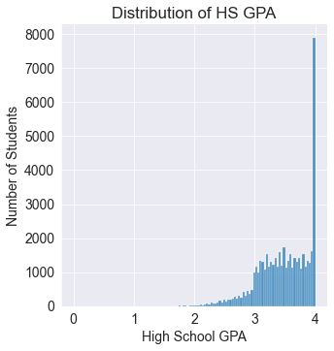
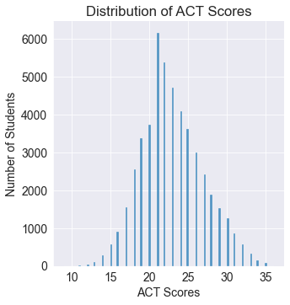
Scholarship Requirements
High School GPA score is 3.0 or greater
ACT score is a minimum of 21
Bill proposes an increase of a 23 or 24

Slide 4
Key Statistics
Assumption – data set provided contained full list of scholarship applicants
49,605 applicants
Average GPA is 3.48
Average ACT score is 22.91
Current ACT requirement (21) has a 99.16% eligibility rate (335 ineligible)
112 No GPA & 316 No ACT

Slide 5
Cost Analysis
Increasing the ACT scores:
Saves money for the TELS program
Reduces student eligibility for TELS scholarships
 | TOTAL COST | SAVINGS | SAVINGS % | ELIGIBLE STUDENTS | ELIGIBILITY % CHANGE
21 ACT Score | $186,499,250 | n/a | n/a | 49,187 | (99.16%)
23 ACT Score | $176,425,250 | $10,074,000 | 5.40% | 46,467 | -5.53%
24 ACT Score | $173,735,250 | $12,764,000 | 6.84% | 45,740 | -7.01%

Slide 6
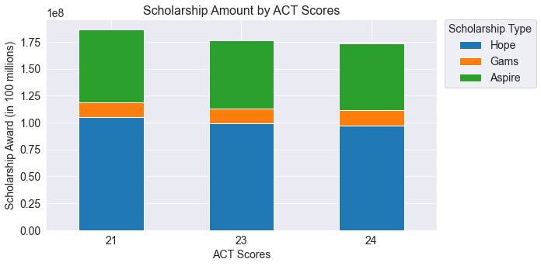
Cost Analysis Visualization

Slide 7
Impact Assessment
Impact methodology:
Difference in distribution percentages between ACT scores of 24 and 21 per variable (Change % = 24 ACT – 21 ACT)
Measures and maximizes the amount of change
Gender had greatest change
Education System, Scholarship Type, Pell-Eligibility, Race, Enrollment Status, Family Income, and Parent Education had less than a 1% change
Gender | 21 ACT | 23 ACT | 24 ACT | Change %
Female | 56.58% | 57.65% | 58.03% | 1.45%
Male | 43.42% | 42.35% | 41.97% | -1.45%

Slide 8
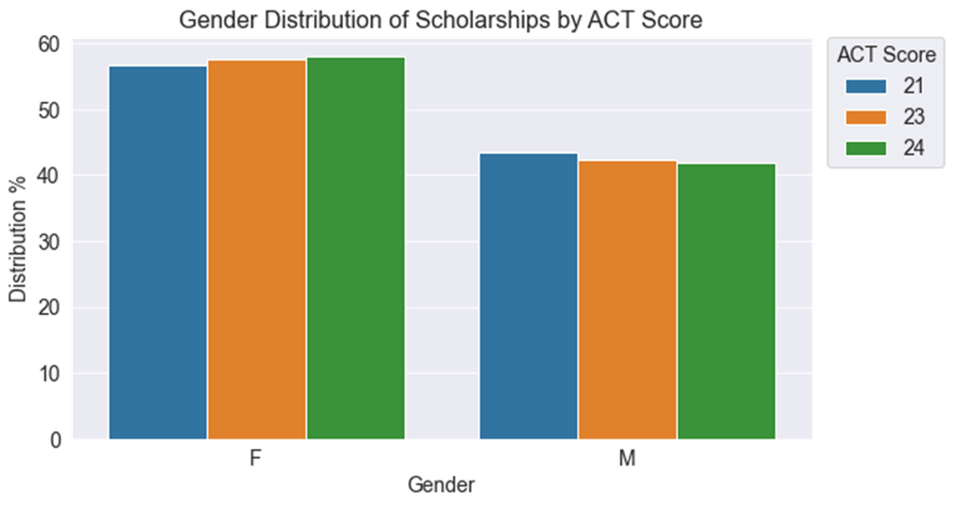
Impact Assessment Visualization

Slide 9
Summary
Increasing the TELS program ACT score requirements saves at least $10 million
Eligibility remains above 92%
Greatest impact: Gender
Gender gap widens by 1.45% to 58/42, (F:M)
All other variables assessed remained consistent
Future Consideration: Impact assessment of GPA increases

Slide 10
Sources
Full Distribution Tables of each variable: (link)
Source Code: (link)
https://www.sureimpact.com/post/impact-assessment-guide
https://harris.uchicago.edu/files/how_to_write_a_policy_memo_that_matters_0.pdf

